Slide 1

Verifying Cyber-Physical Systems
Chapter 7 – Verifying Invariants
Abenezer Taye
Oct 10, 2022

Slide 2
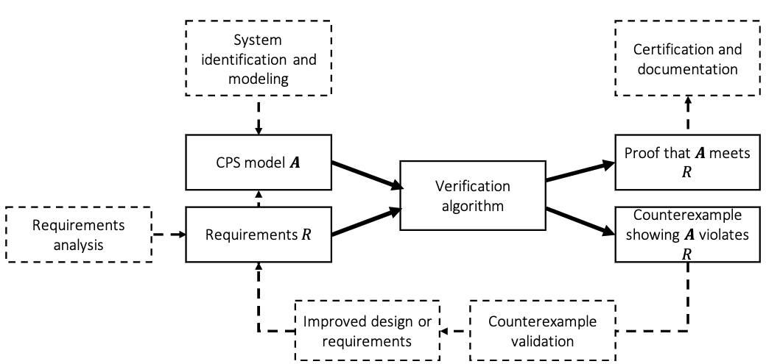
System Design Ecosystem

Slide 3
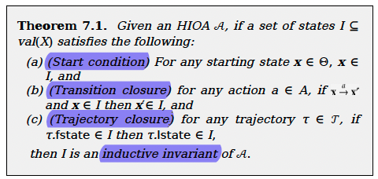
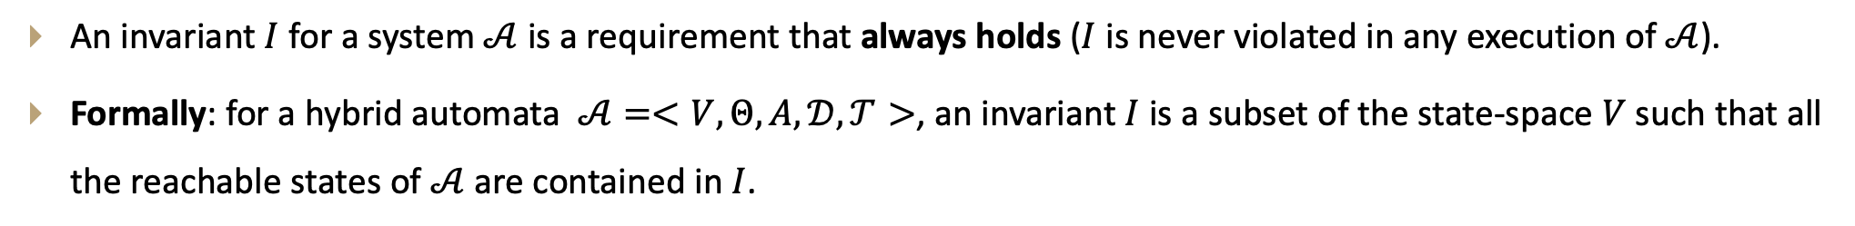
What is an invariant?
An invariant $I$ for a system $𝒜$ is a requirement that always holds ($I$ is never violated in any execution of $𝒜$).
Formally: for a hybrid automata $𝒜=<V, Θ,A,𝒟,𝒯>$, an invariant $I$ is a subset of the state-space $V$ such that all the reachable states of $𝒜$ are contained in $I$.

Slide 4
Historical perspective on invariants
The idea of Invariants dates to the classical program analysis technique called Floyd-Hoare style verification (Floyd, 1967).
Hoare logic/ Floyd-Hoare logic/ Hoare rules – provides a set of logical rules for rigorously deducing the correctness of automata or programs.
Hoare logic is built on a notion called Hoare triple – describes how the execution of a statement changes the state of the automaton.
Hoare logic provide axioms and inference rules that various programming language constructs can use to infer properties from the triples.

Slide 5
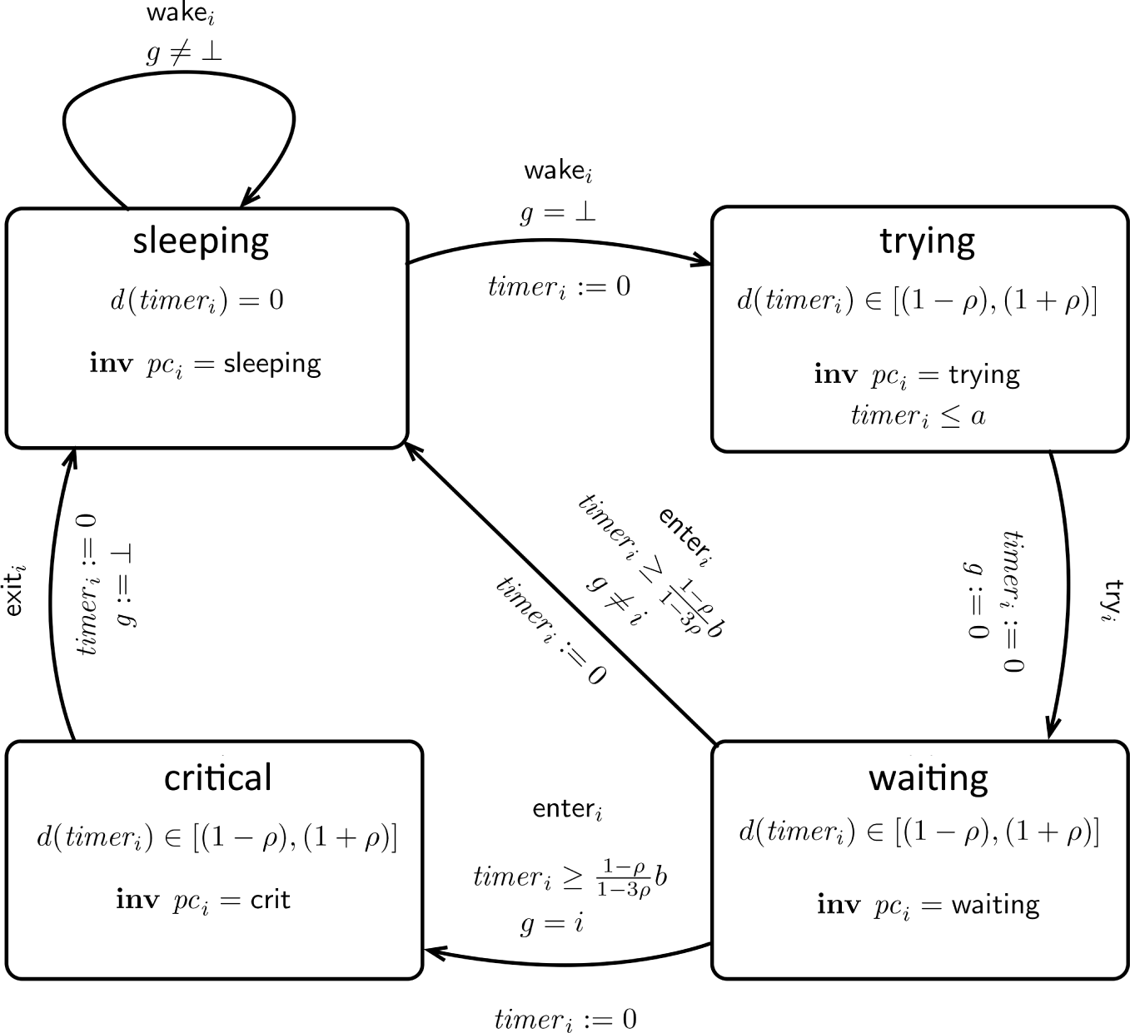

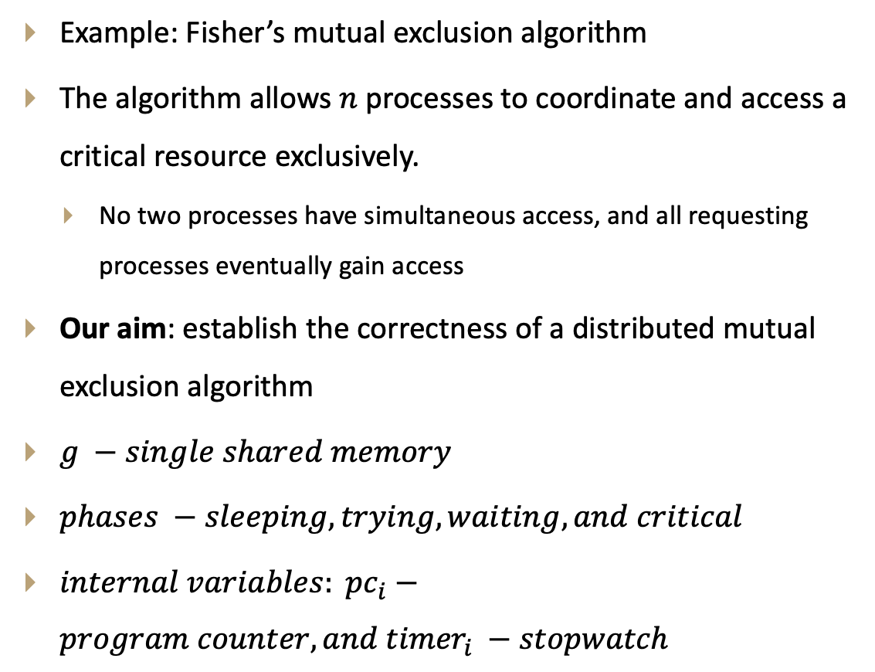
Proving invariants via inductive reasoning
Example: Fisher’s mutual exclusion algorithm
The algorithm allows $n$ processes to coordinate and access a critical resource exclusively.
No two processes have simultaneous access, and all requesting processes eventually gain access
Our aim: establish the correctness of a distributed mutual exclusion algorithm
$g −single shared memory$
$phases −sleeping, trying, waiting, and critical$
$internal variables: {pc}_{i}−program counter, and {timer}_{i} −stopwatch$
$$internal actions:wake, try, enter, exit$$

Slide 6
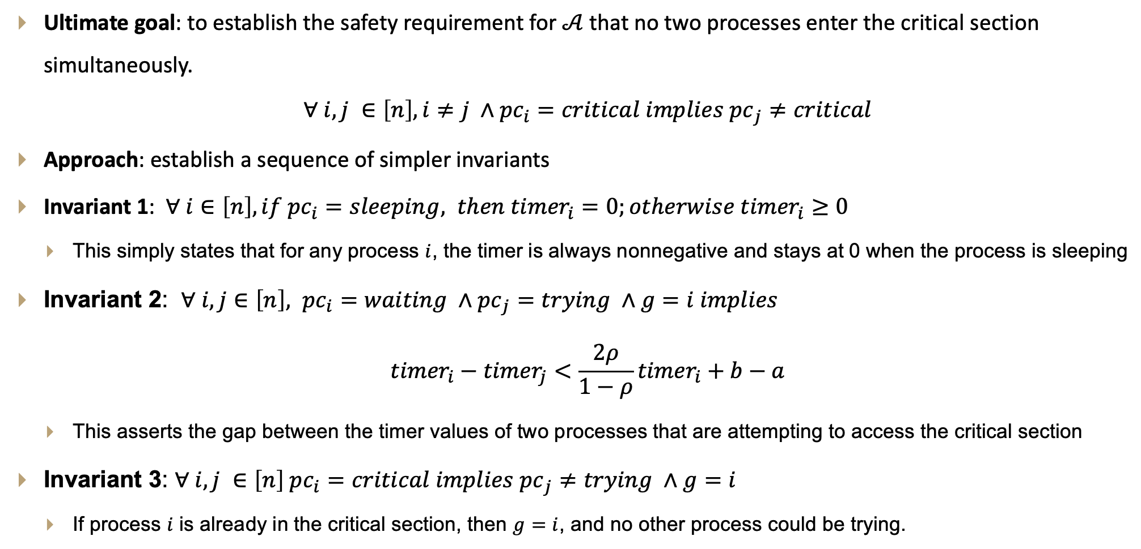
Analysis of Fisher’s mutual exclusion
Ultimate goal: to establish the safety requirement for $𝒜$ that no two processes enter the critical section simultaneously.
$$∀ i,j ∈\left[n\right], i≠j ∧{pc}_{i}=critical implies {pc}_{j}≠critical$$
Approach: establish a sequence of simpler invariants
Invariant 1: $∀ i∈\left[n\right], if {pc}_{i}=sleeping, then {timer}_{i}=0;otherwise {timer}_{i}≥0$
This simply states that for any process $i$, the timer is always nonnegative and stays at 0 when the process is sleeping
Invariant 2: $∀ i,j∈\left[n\right], {pc}_{i}=waiting ∧{pc}_{j}=trying ∧g=i implies$
$${timer}_{i}−{timer}_{j}<\frac{2ρ}{1−ρ}{timer}_{i}+b−a$$
This asserts the gap between the timer values of two processes that are attempting to access the critical section
Invariant 3: $∀ i,j ∈\left[n\right] {pc}_{i}=critical implies {pc}_{j}≠trying ∧g=i$
If process $i$ is already in the critical section, then $g=i$, and no other process could be trying.

Slide 7
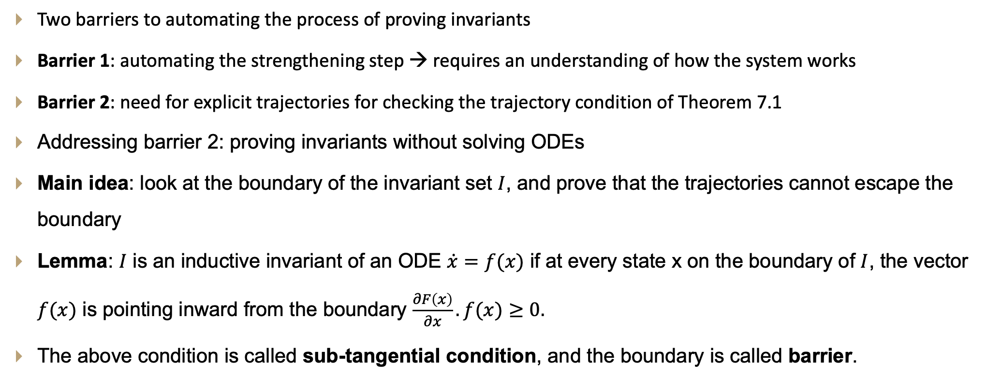
Barriers to automated invariant proving
Two barriers to automating the process of proving invariants
Barrier 1: automating the strengthening step → requires an understanding of how the system works
Barrier 2: need for explicit trajectories for checking the trajectory condition of Theorem 7.1
Addressing barrier 2: proving invariants without solving ODEs
Main idea: look at the boundary of the invariant set $I$, and prove that the trajectories cannot escape the boundary
Lemma: $I$ is an inductive invariant of an ODE $\dot{x}=f(x)$ if at every state x on the boundary of $I$, the vector $f(x)$ is pointing inward from the boundary $\frac{∂F\left(x\right)}{∂x}.f(x)≥0.$
The above condition is called sub-tangential condition, and the boundary is called barrier.

Slide 8
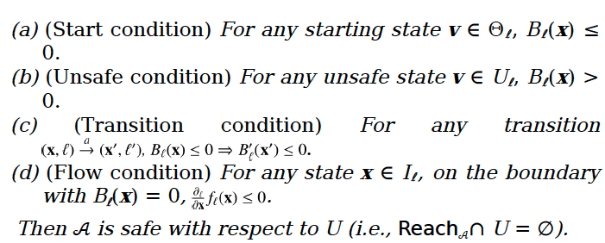
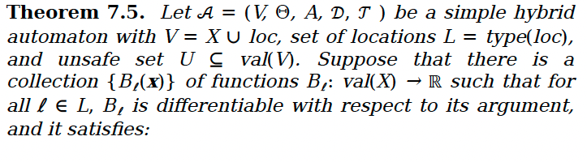
Barrier certificates
They can be used to construct safety proofs relative to an unsafe set.
Key idea: find a barrier function that separates the unsafe set from the reachset

Slide 9
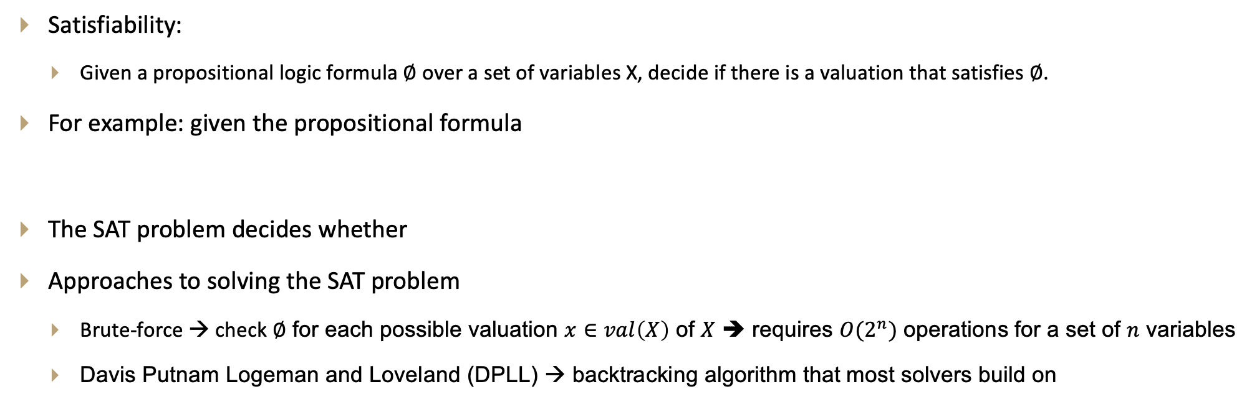
Satisfiability and satisfiability modulo theories
Satisfiability:
Given a propositional logic formula $∅$ over a set of variables X, decide if there is a valuation that satisfies $∅$.
For example: given the propositional formula
The SAT problem decides whether
Approaches to solving the SAT problem
Brute-force → check $∅$ for each possible valuation $x∈val\left(X\right)$ of $X$ ➔ requires $O(2^{n})$ operations for a set of $n$ variables
Davis Putnam Logeman and Loveland (DPLL) → backtracking algorithm that most solvers build on

Slide 10
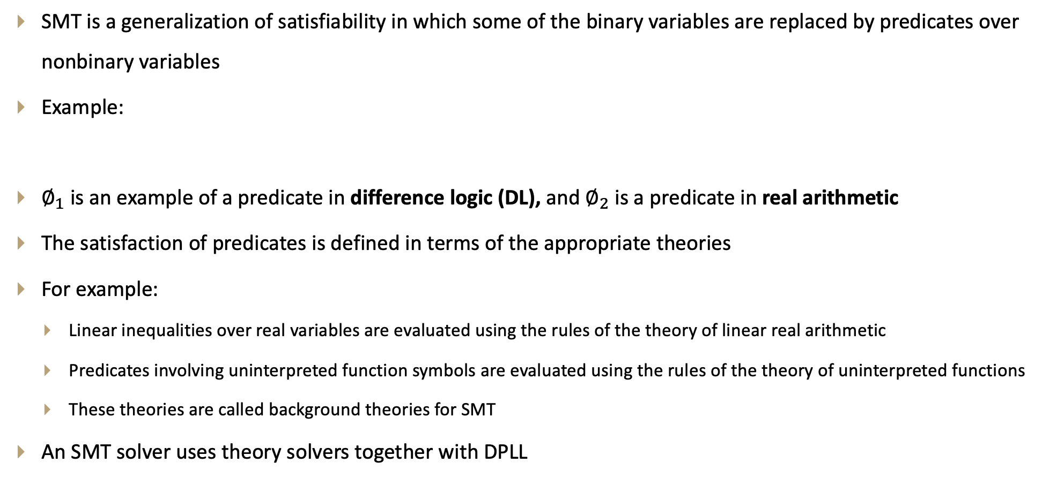
Satisfiability modulo theory (SMT)
SMT is a generalization of satisfiability in which some of the binary variables are replaced by predicates over nonbinary variables
Example:
$∅_{1}$ is an example of a predicate in difference logic (DL), and $∅_{2}$ is a predicate in real arithmetic
The satisfaction of predicates is defined in terms of the appropriate theories
For example:
Linear inequalities over real variables are evaluated using the rules of the theory of linear real arithmetic
Predicates involving uninterpreted function symbols are evaluated using the rules of the theory of uninterpreted functions
These theories are called background theories for SMT
An SMT solver uses theory solvers together with DPLL

Slide 11
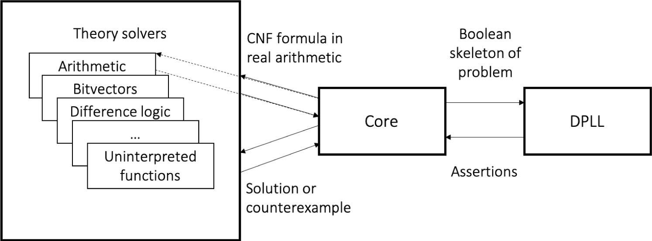
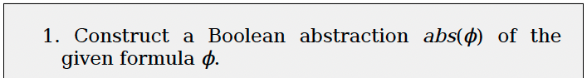
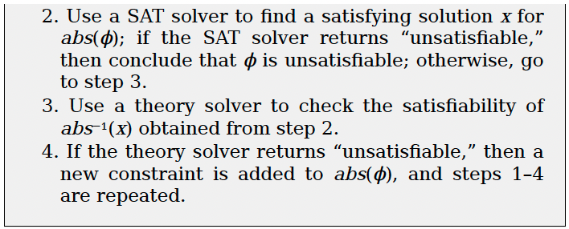
Combine theory solvers with DPLL
Lazy approach to combine theory solvers with DPLL

Slide 12
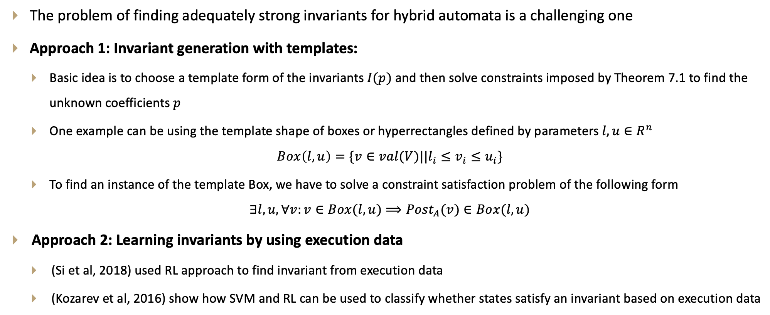
Finding and learning invariants
The problem of finding adequately strong invariants for hybrid automata is a challenging one
Approach 1: Invariant generation with templates:
Basic idea is to choose a template form of the invariants $I(p)$ and then solve constraints imposed by Theorem 7.1 to find the unknown coefficients $p$
One example can be using the template shape of boxes or hyperrectangles defined by parameters $l,u∈R^{n}$
$$Box\left(l,u\right)=\{v∈val(V)||l_{i}≤v_{i}≤u_{i}\}$$
To find an instance of the template Box, we have to solve a constraint satisfaction problem of the following form
$$∃l,u, ∀v:v∈Box(l,u)⟹{Post}_{A}(v)∈Box(l,u)$$
Approach 2: Learning invariants by using execution data
(Si et al, 2018) used RL approach to find invariant from execution data
(Kozarev et al, 2016) show how SVM and RL can be used to classify whether states satisfy an invariant based on execution data

Slide 13
Thank You!!!
Q&A

